Slide 1
Transport in humans - The circulatory system
https://www.khanacademy.org/science/high-school-biology/hs-human-body-systems/hs-the-circulatory-and-respiratory-systems/v/meet-the-heart
IGCSE Biology
Wendy Chai

Slide 2
Question list part I
1. What organs make up human circulatory system?
2. By “double circulation system”, what does “double” mean?
3. Suggest advantages of a double circulatory system, compared to a single circulation system.
4. a) What are the names of four chambers in a mammalian heart?
b) What is the role of septum? Imagine removing the septum, what problem may there be?
c) In a heart, is the blood oxygenated or deoxygenated?
d) Which structure controls heartbeat rate?
e) What is name of the muscle cells that makes up walls of the heart?
g) Which chamber receives blood from the lungs/ the body? Which chamber pumps blood to the lungs/ the body?
5. a) What structures make sure blood flow in one-way direction?
b) How do atrioventricular valves work? Where are they?
6. a) Compare the thickness of the walls in the human heart (atria vs. ventricles; left vs. right ventricles).
b) Can you explain the difference in this thickness?
7. a) Describe how an O₂ molecule in air is delivered to a muscle cell in your arm. (starting from when blood return to right atrium)
b) Describe how a glucose molecule in intestinal lumen is delivered to a muscle cell in your arm. (starting from when glucose is inside the lumen)

Slide 3
Question list part II
8. How can you know measure your heartbeat rate? List 3 means.
9. a) Which blood vessel supplies blood to heart muscle cells?
b) What are the risking factors of CHD? How do we prevent CHD?
c) Treatments of CHD? (in terms of drugs, surgery in detail and lifestyle)
10. a) What is an artery? Its function? How is it adapted?
b) What is a vein? Its function? How is it adapted?
c) What is a blood capillary? Its function? How is it adapted?
d) Describe the relationship between artery, vein, capillary, arteriole and venule.
11. The wall of an artery and a vein can be divided into 3 layers. What are the main components/ features of each layer?
12. What are names of blood vessels that deliver blood to/ enter and exiting from the a) liver, b) lung, c) kidney.
d) what is the function of a hepatic portal vein?

Slide 4
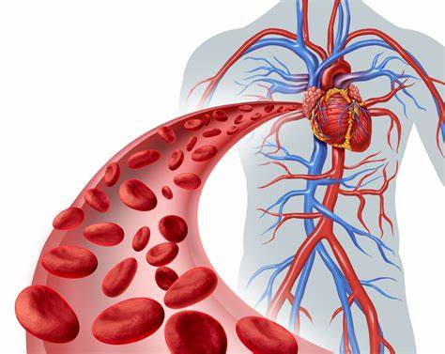
The circulatory system
The circulatory system is often seen to comprise two separate systems: the cardiovascular system, which distributes blood, and the lymphatic system, which circulates lymph.
The cardiovascular system is a system of tubes with a pump and valves to make sure that blood flows in one direction only.
The pump is the heart
The tubes are the blood vessels

Slide 5
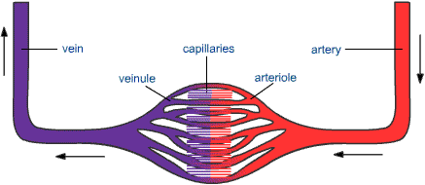
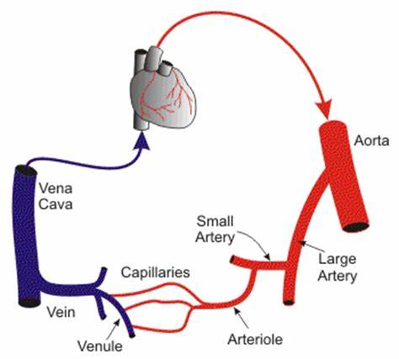
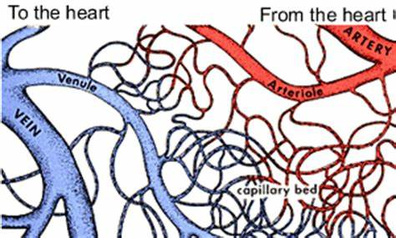
The circulatory system
Back to the heart
From the heart

Slide 7
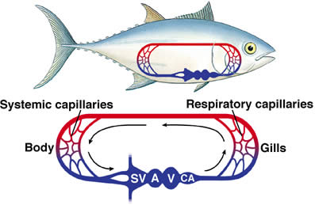
Single circulation
In fish there is a single circulatory system.
Blood leaves the heart and travels to the gills, where it picks up oxygen, before continuing around the body.

Slide 8
Double circulation
Mammals have a double circulatory system means that blood travels through the heart twice on each circuit of the body.
There is a low pressure circulation that takes blood to the lungs to pick up oxygen, then returns it to the heart - pulmonary system.
There is a high pressure circulation to the body tissues and back to the heart - systemic system.

Slide 9
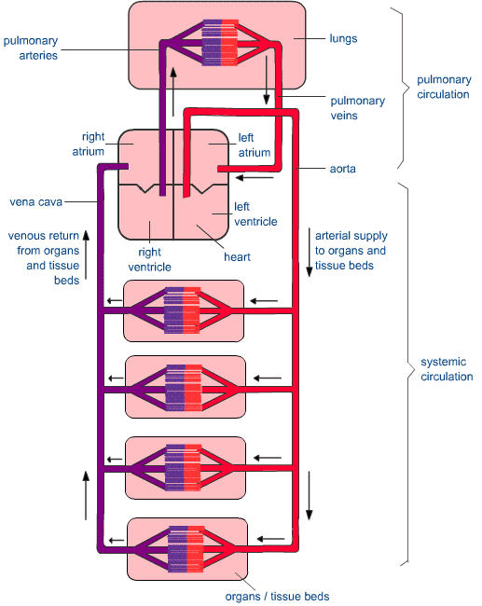
Double circulation
Lower pressure
Mammals, including humans, have a double circulation system.
Blood travels through the heart twice on each circulation of the body.
Higher pressure

Slide 10
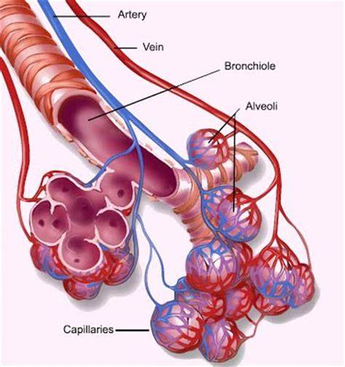
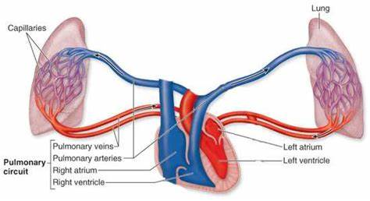
Double circulation – pulmonary system

Slide 11
Advantages of a double circulation
In a fish pressure is lost in the capillaries in the gills.
Oxygenated blood can be pumped round the body at a higher pressure and, therefore, faster in a mammal than in a fish.
This provides a more efficient system in mammals than in fish.

Slide 12
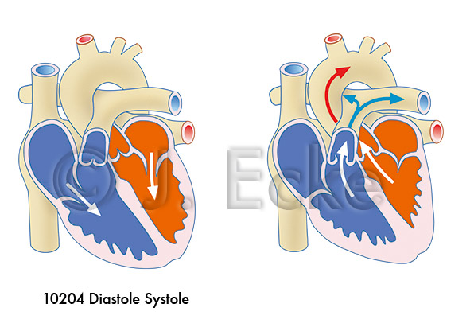
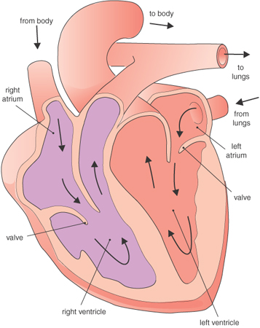
The heart structure
Aorta
Vena cava
Pulmonary artery
The heart is made up of four chambers:
two upper atria and two lower ventricles.
The left and right sides of the heart are separated by the septum – which separates deoxygenated from oxygenated blood.
Pulmonary vein
Bicuspid/ mitral valve
Tricuspid valve
Septum

Slide 13
The heart structure
Aorta
Vena cava
Valves, including the tricuspid, bicuspid/ mitral and 2 semi-lunar valves (in aorta and pulmonary artery, not shown) make sure the blood can only flow in one direction (do not flow backwards).
Pulmonary artery
Pulmonary vein
Bicuspid/ mitral valve
Tricuspid valve
https://www.infobloom.com/what-are-semilunar-valves.htm
Septum
Notes:
The heart has two types of valves: the atrioventricular (AV) and semilunar. The semilunar valves are shaped like half moons and have three cusps, or flaps.
Semilunar valve, either of two heart valves of which one occurs between the heart and the aorta and the other between the heart and pulmonary artery and that consist of three crescent-shaped flaps that are forced apart by pressure in the ventricles during systole and pushed together by pressure in the arteries during diastole and which prevent regurgitation of blood into the ventricles.
The semilunar valves (SV) are two valve structures that sit between the right ventricle and the pulmonary artery and between the left ventricle and the aorta. The flaps of the valves open and close to allow the unidirectional flow of blood out of the heart, while preventing backflow of blood. The valve between the left ventricle and aorta is called the aortic valve and the valve between the pulmonary artery and right ventricle is called the pulmonary valve.

Slide 14
Blood circulation
Aorta
Vena cava
Blood from the body enters the heart by the vena cava.
Deoxygenated blood is pumped to the lungs in the pulmonary artery.
Pulmonary artery
Pulmonary vein
Bicuspid/ mitral valve
Tricuspid valve
Septum

Slide 15
Blood circulation
Aorta
Oxygenated blood returns to the heart from the lungs in the pulmonary vein.
Blood is finally pumped to the rest of the body in the aorta.
Vena cava
Pulmonary artery
Pulmonary vein
Bicuspid/ mitral valve
Tricuspid valve
Septum

Slide 16
The heart structure – cardiac muscle
Skeletal muscle: This type of muscle creates movement in the body. There are more than 600 skeletal muscles, and they makes up about 40 percent of a person’s body weight.
Cardiac muscle: This type makes up the walls of the heart and creates the steady, rhythmic pulsing that pumps blood through the body.
Smooth muscle: Smooth muscle makes up the walls of hollow organs, respiratory passageways, and blood vessels. Its wavelike movements propel things through the bodily system, such as food through your stomach.

Slide 17
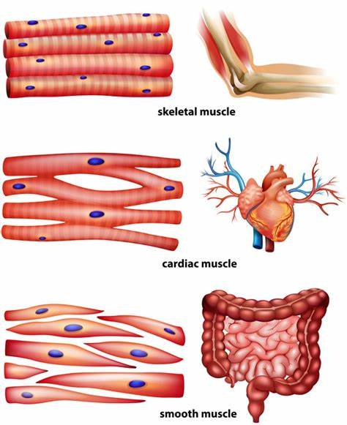


Slide 18
The muscular walls
Aorta
Vena cava
Pulmonary artery
The heart wall is made of cardiac muscle.
Pulmonary vein
Bicuspid valve
Atria VS. Ventricles
Tricuspid valve
Left VS. Right ventricle
Septum

Slide 19
The muscular walls
Aorta
Vena cava
The muscle of the wall of the right ventricle is relatively thin, as it only has to pump blood as far as the lungs.
Pulmonary artery
Pulmonary vein
Bicuspid valve
The muscle of the wall of the left ventricle is relatively thicker, as it has to pump blood round the whole body.
Tricuspid valve
Septum

Slide 20
Cardiac cycle – 3 stages
The heart beats approximately 70 times a minute in a healthy adult.
Three stages during one heart beat:
1) Diastole
All cardiac muscles are relaxed, and hence the pressure inside the heart is lower.
Blood flows into the left and right atria.

Slide 21
Cardiac cycle – 3 stages
2) Atrial systole
After the blood enters the heart, the muscles in the walls of the atria contract.
Blood is forced into the ventricles through the tricuspid and bicuspid valves.
Valves open or close passively in response to pressure changes.

Slide 22
Cardiac cycle – 3 stages
3) Ventricular systole
Next the muscles in the walls of the ventricles contract.
The tricuspid and bicuspid valves are forced shut by the pressure of blood.
The semi-lunar valves are open by the pressure of blood.
Blood is forced out of the heart into the pulmonary artery and the aorta.

Slide 23
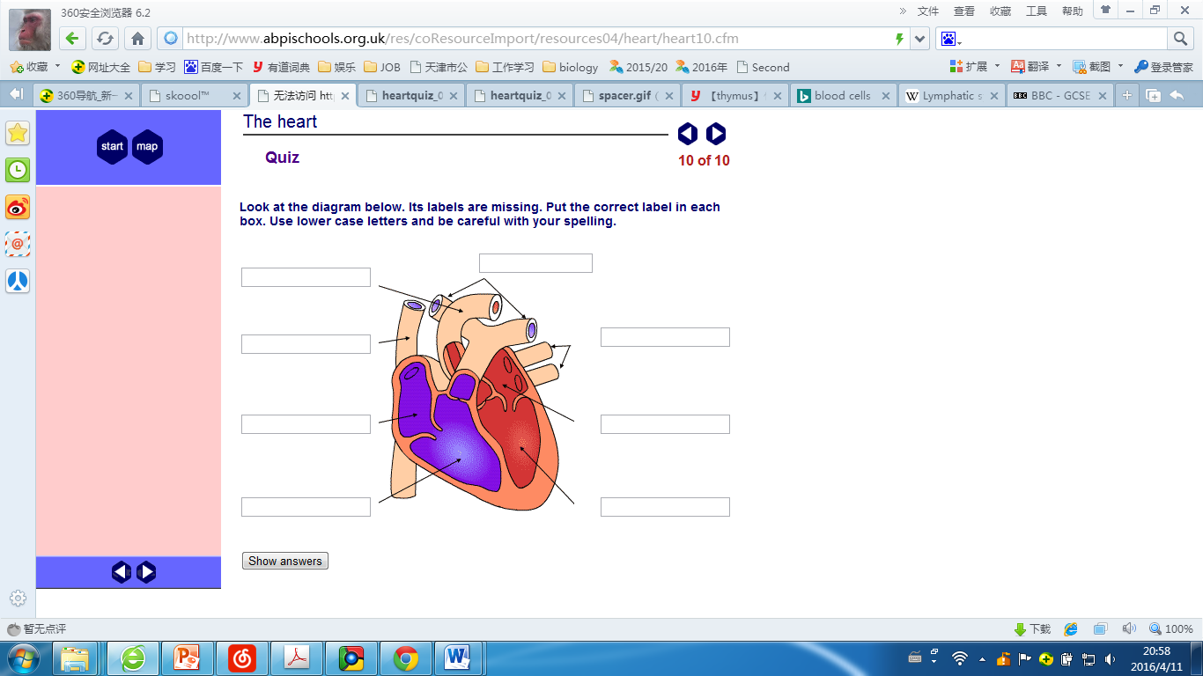
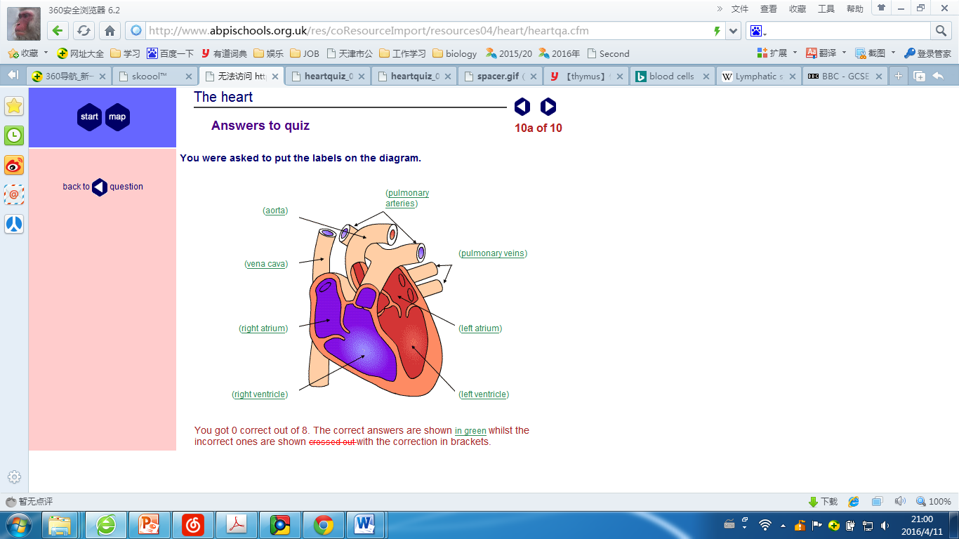

Slide 24
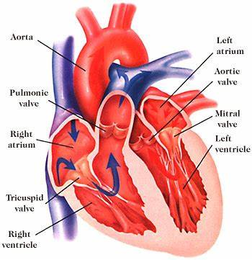
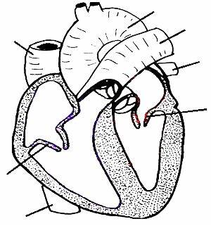
The heart structure

Slide 25
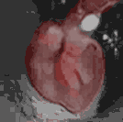
Heart beat
Picture 9.1 A heart in the chest cavity of a person having open heart surgery. The heart is beating.
Task: Construct a table to record the responses/ actions of atria/ ventricles/ atrioventricular valves/ blood flow during a cardiac cycle.
Stages | atria | ventricles | atrioventricular valves | blood flow
diastole
atrial systole
ventricular systole

Slide 26
cardiac arrest
Game: cardiac arrest (group of 5-7 students)
Figure out a list of structures the blood flow pass, during one circuit, then call out the structure name one by one.
If anyone stops more than 2s, start the cycle again until the group can finish 2 heartbeats.

Slide 27
Pacemaker
The heartbeat rate is controlled by a patch of muscle in the right atrium called sinoatrial node (SAN) or pacemaker.
The SAN sends out an electrical impulse which spreads throughout to the atria first, to stimulate it to contract.
After the atria contract, the electrical impulse moves on and is sent to ventricles, which contract also.

Slide 28
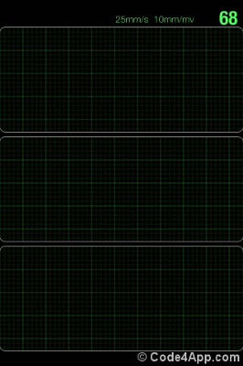
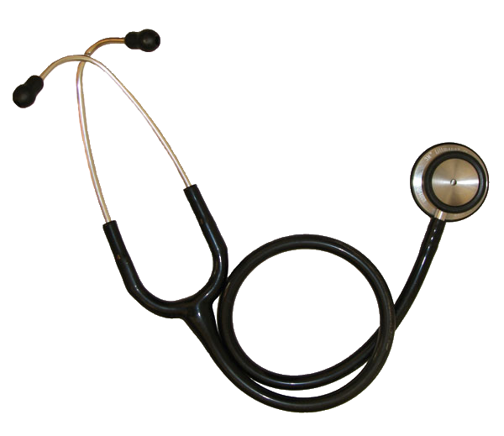
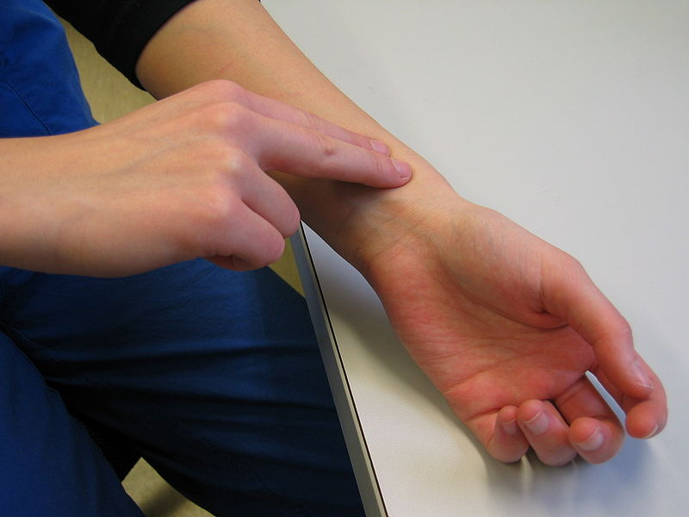
Detect heart activity
Stethoscope - listen to the sound of valves when they shut
Pulse evaluation – arteries pulses while blood go through
Electrocardiography (ECG) – records the electrical activity of the heart

Slide 29
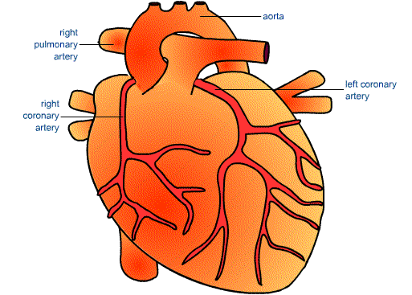
The coronary artery
The heart muscle is supplied with nutrients, such as glucose, and oxygen by the coronary arteries.
Waste materials, such as carbon dioxide are removed in the coronary veins.

Slide 30
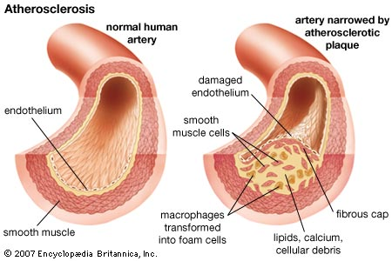
Coronary heart disease (CHD)
A heart attack involves death of an area of heart tissue followed by an interrupted blood supply - usually when the coronary artery is narrowed by fatty deposits.

Slide 31
Heart disease and preventing
Heart disease can be caused by a number of factors such as:
Cigarette smoking
Inappropriate diet
High blood cholesterol & high blood pressure
Obesity
Lack of regular exercise
Stress
Genes (family history)

Slide 32
Treating CHD
Drugs:
1) statins, to lower blood cholesterol content， other effects such as improved endothelial function, reduced inflammation, and reduced thrombus formation
2) aspirin, to reduce blood clots forming
Surgery:
a) stenting
b) angioplasty – balloon catheter
c) coronary bypass operation
d) heart transplant

Slide 33
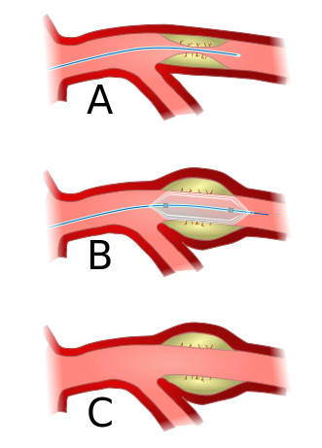
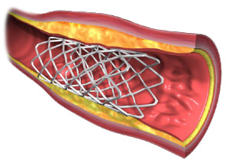
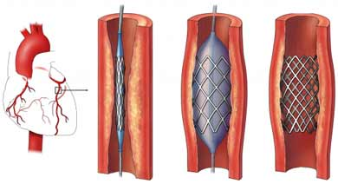
stenting
b) angioplasty – balloon catheter

Slide 34
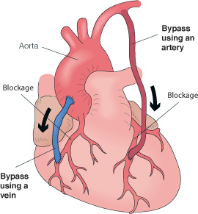
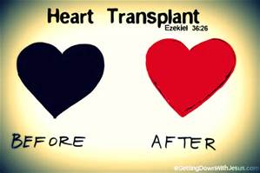
c) coronary bypass operation
d) heart transplant

Slide 35
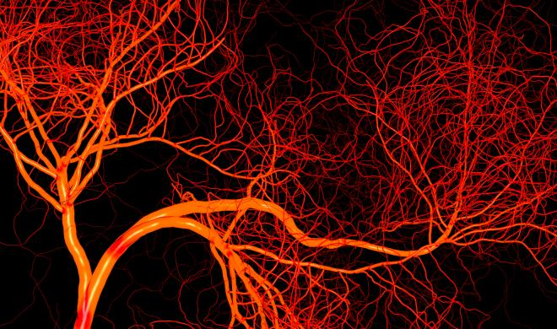
Blood vessels

Slide 36
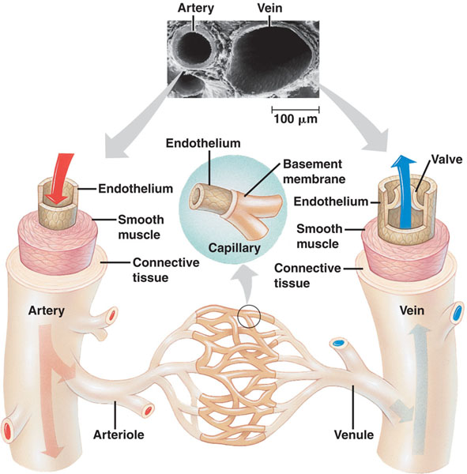
Blood vessels

Slide 37
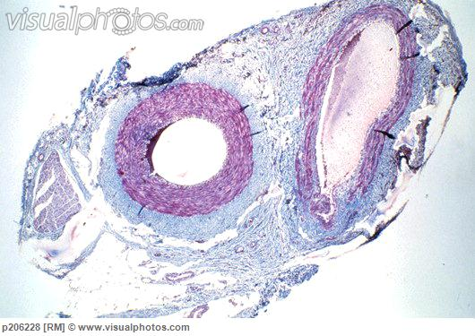
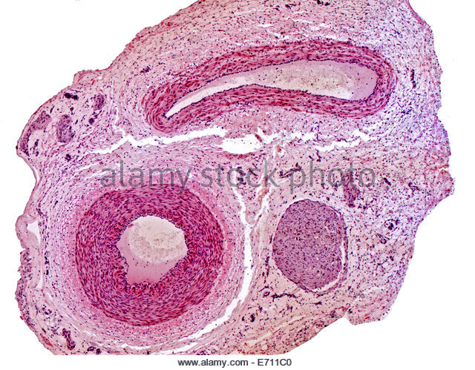
Histology
http://www.histologyguide.org/slidebox/09-cardiovascular-system.html#Elastic_AV

Slide 38
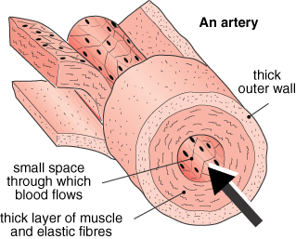
Arteries
Three layers:
Thick outer wall (collagen & elastic fibres)
Thick muscular wall
Inner lining (single layer, squamous epithelium)
Arteries have thick, muscular, elastic walls with a narrow lumen.
They do not contain valves, as blood flows under high pressure.
Lumen

Slide 39
Arteries
A pulse can be felt where an artery crosses a bone.
Arteries carry blood away from the heart.
They carry oxygenated blood, (apart from the pulmonary artery).
Lumen

Slide 40
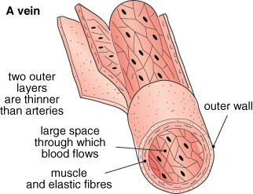
Veins
Three layers;
Veins have thin, non-muscular walls with a large lumen.
They contain valves to prevent the backward flow of blood under low pressure.
Lumen

Slide 41
Veins
There is no pulse.
Veins carry blood back to the heart.
They carry deoxygenated blood, (apart from the pulmonary vein).
Lumen

Slide 42
Important arteries and veins
Organ involved | Vessel supplying blood | Vessel taking blood away
Heart | Vena cava Coronary artery | Aorta Coronary vein
Lungs | Pulmonary artery | Pulmonary vein
Liver | Hepatic artery Hepatic portal vein | Hepatic vein
Kidney | Renal artery | Renal vein
The hepatic portal vein carries dissolved nutrients, such as glucose and amino acids, from the small intestine to the liver.

Slide 43
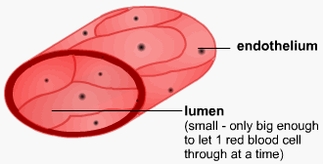
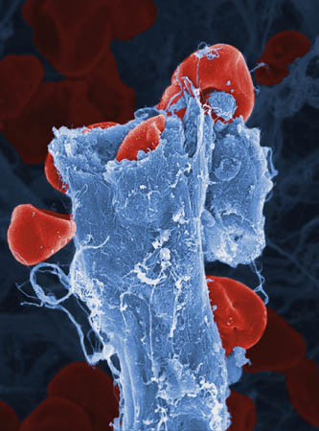
Capillaries
Capillary wall
Walls only one cell thick. This means materials only have a short distance to diffuse.
Capillaries have a very large surface area and are where the exchange of materials between blood and tissue fluid takes place.

Slide 44
 | Arteries | Capillaries | Veins
Carry blood (direction): | away from the heart | from arteries to veins | towards the heart
Pressure: | high | low | very low
Walls are: | thick and muscular with elastic fibres | very thin - one cell thick | thin
lumen | narrow | Very narrow, | large
Blood is: | oxygenated (except pulmonaryartery) | exchanging nutrients and gases with cells | de-oxygenated (except pulmonary vein)
Pulse: | Strong | none | none

Slide 45
Resources
1. animation – blood and circulation:
http://inteleducationresources.intel.co.uk/content/keystage4/biology/pc/modules/blood_and_circulation/circulation
2. exercise on heart risks – further reading:
http://www.abpischools.org.uk/res/coResourceImport/resources04/heart/heart8.cfm
3. The Franklin Institute – further reading:
https://www.fi.edu/heart-engine-of-life

